Slide 1


React JS
(mini project)
Lecture-25

Slide 2
Today’s Agenda
Creating A ToDo List App
Apply All The Concepts Learnt Till Now

Slide 3
Mini Project
Develop a TodoList app which allows the user to:
Add a new ToDo
Delete an existing ToDo
Edit the ToDo
Set the ToDo as completed or not completed

Slide 4
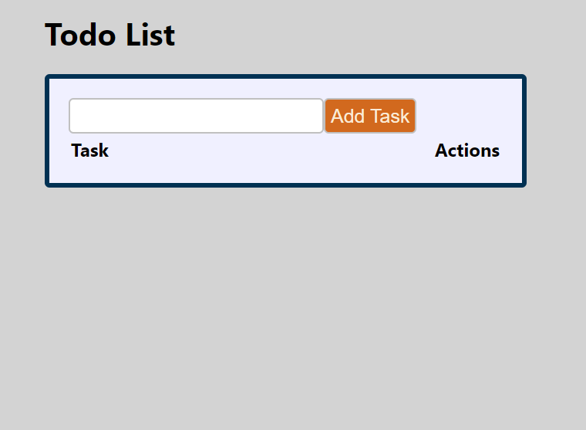
Desired Output

Slide 5
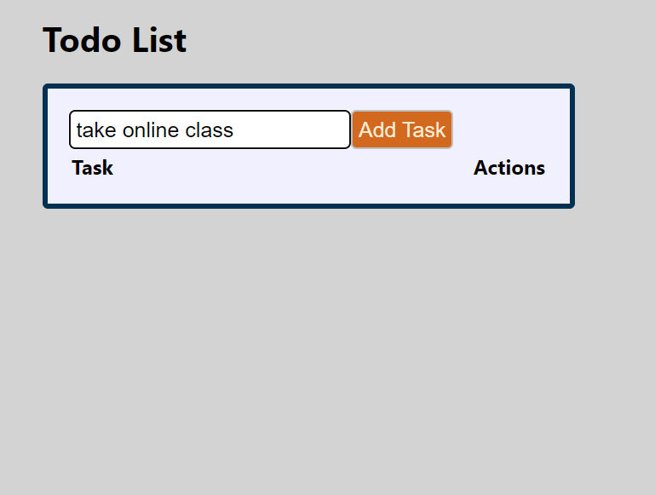
Desired Output

Slide 6
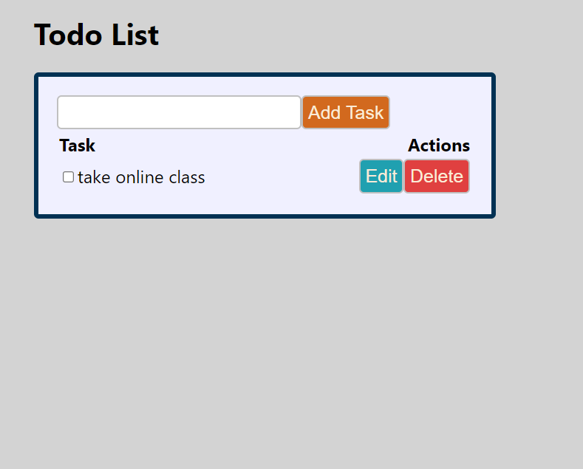
Desired Output

Slide 7
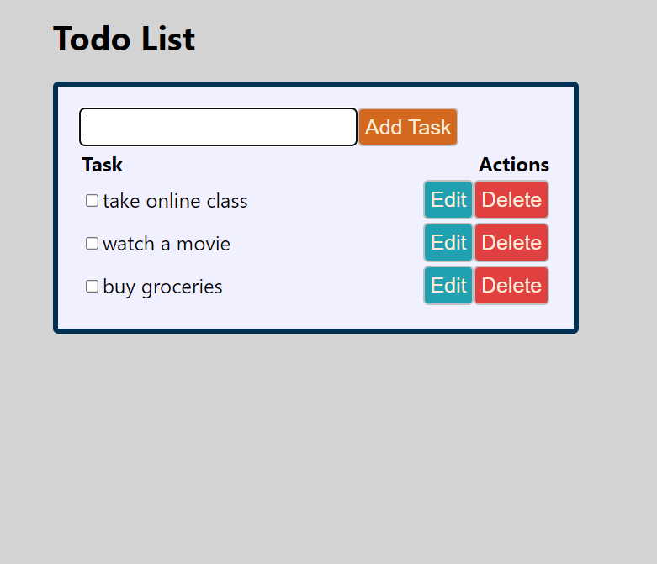
Desired Output

Slide 8
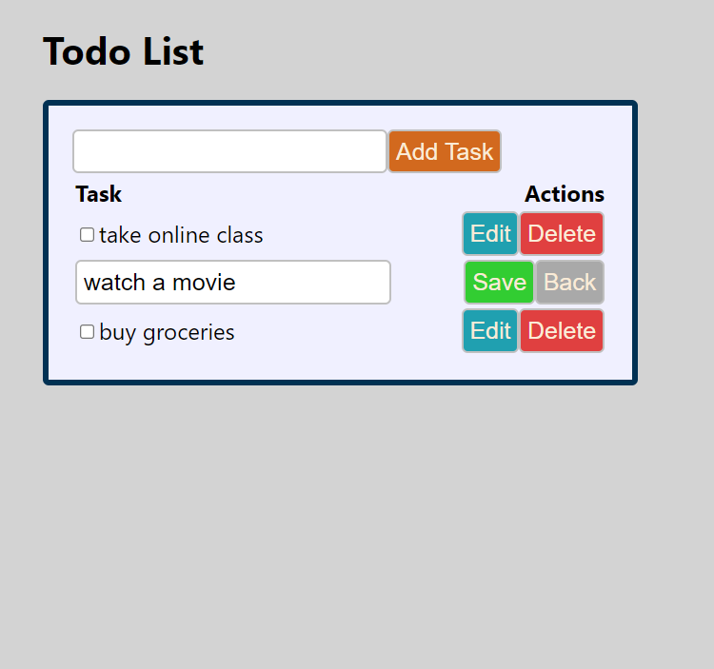
Desired Output

Slide 9
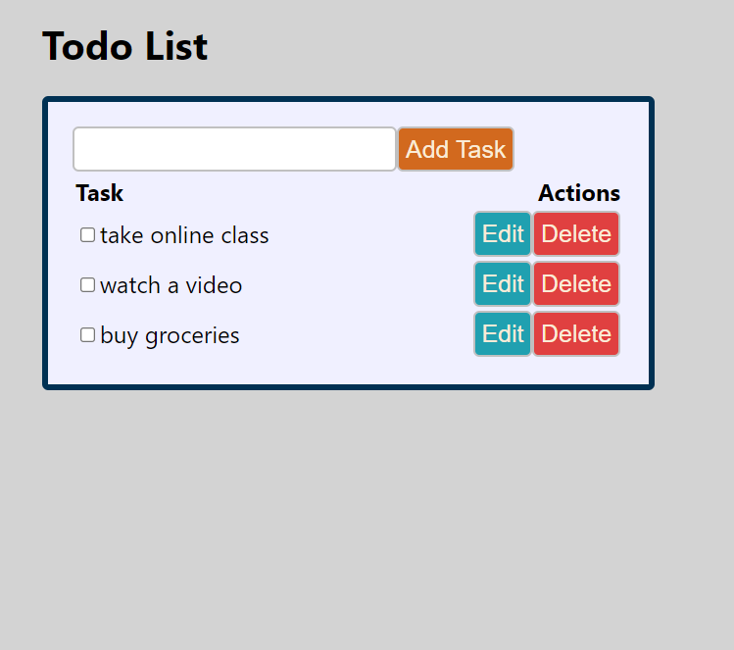
Desired Output

Slide 10
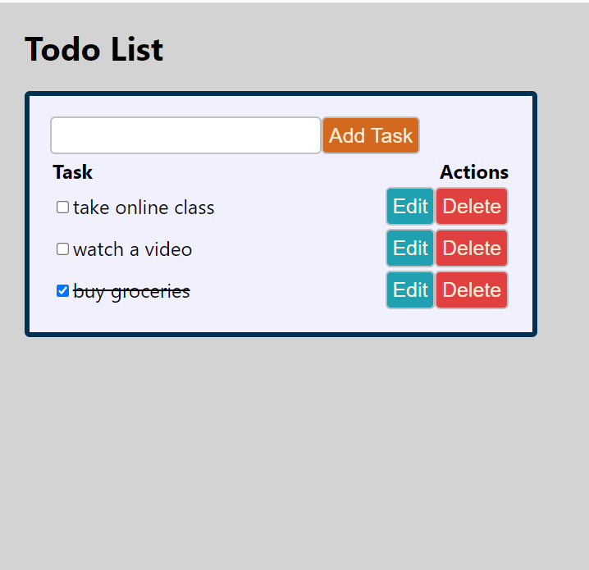
Desired Output

Slide 11
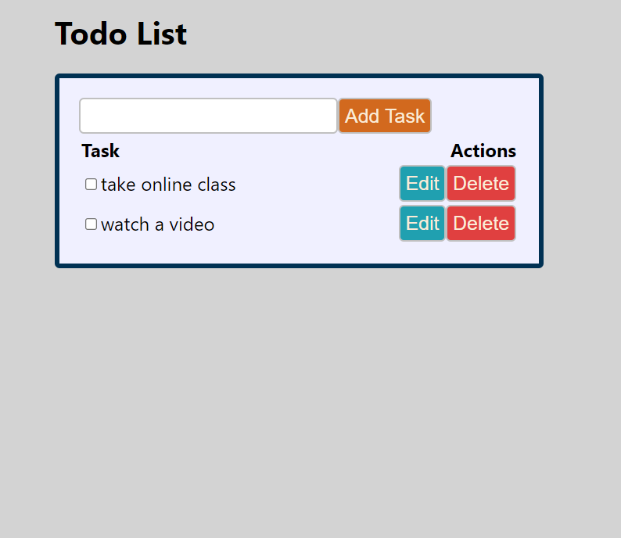
Desired Output

